Slide 1
Dynatrace for Cooper Suits
Mark Bley

Slide 2
Cooper Suits
135 stores in 30 states
~20 Mio requests per day !
Largest store operators in U.S.

Slide 3
But...
85% of network traffic handled by third party

Slide 4
But...
85% of network traffic handled by third party
Very expensive

Slide 5
But...
85% of network traffic handled by third party
Very expensive
Customer relationship/interaction is impaired

Slide 6
But...
85% of network traffic handled by third party
Very expensive
Customer relationship/interaction is impaired
Troubleshooting

Slide 7
There is more...
Move of all OPs to Cloud Foundry

Slide 8
There is more...
Move of all OPs to Cloud Foundry
Full visibility of cloud infrastructure

Slide 9
There is more...
Move of all OPs to Cloud Foundry
Full visibility of cloud infrastructure
A LOT of data

Slide 10
There is more...
Move of all OPs to Cloud Foundry
Full visibility of cloud infrastructure
A LOT of data
Overview and monitor this infrastructure:
More tools, knowledge, time and money !

Slide 11
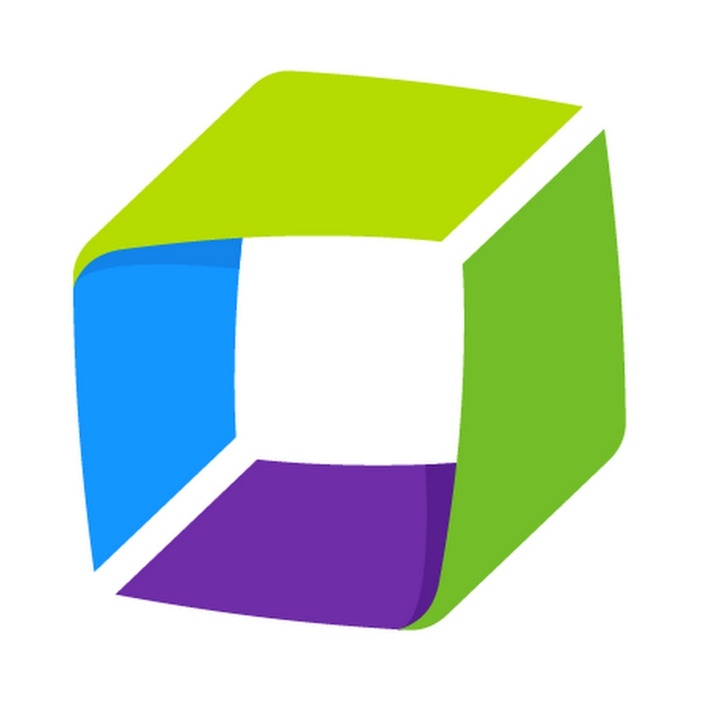
Welcome to Dynatrace !

Slide 12
Welcome to Dynatrace !
Enterprise cloud monitoring driven by AI

Slide 13
Welcome to Dynatrace !
Enterprise cloud monitoring driven by AI
Deployment with one line of code !
One agent !

Slide 14
Welcome to Dynatrace !
Enterprise cloud monitoring driven by AI
Deployment with one line of code !
One agent !
Autonomous discovery of network

Slide 15
Welcome to Dynatrace !
Enterprise cloud monitoring driven by AI
Deployment with one line of code !
One agent !
Autonomous discovery of network
Platform independent:
Linux
Windows
Apple

Slide 16
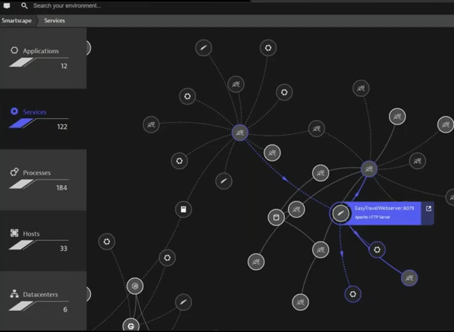
Smartscape

Slide 17
Smartscape
Full stack view
All Interconnections

Slide 18
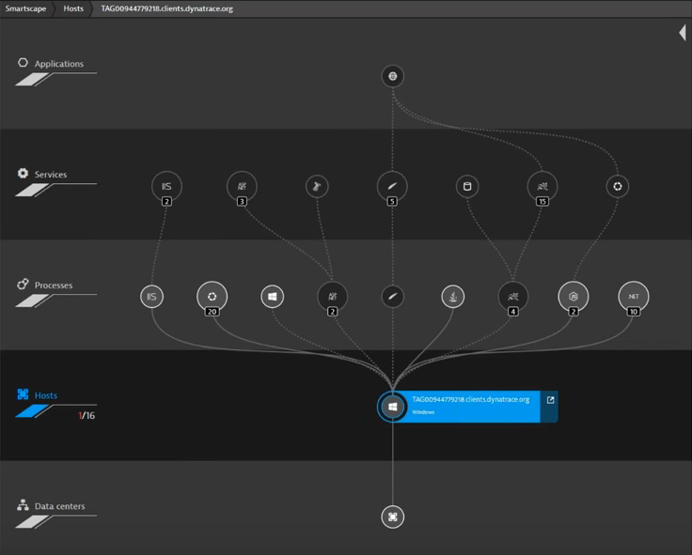
Smartscape
Full stack view
All Interconnections

Slide 19
Issue monitoring
Replay problem in real time
Finds root cause
Item for issue automatically created
Who got affected
What was impacted

Slide 20
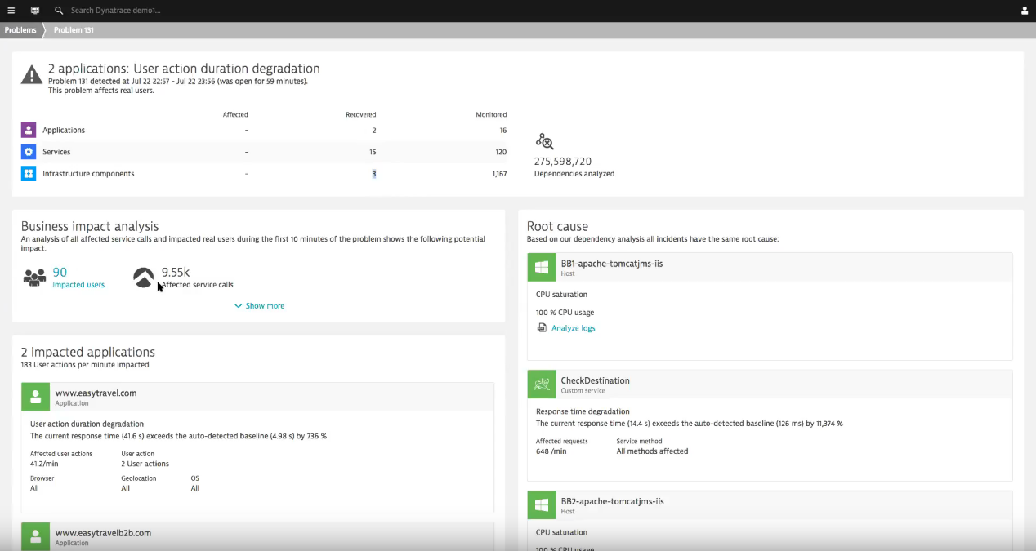
Issue monitoring
Replay problem in real time
Item automatically created
Who got affected
What was impacted

Slide 21
User monitoring
Independent User ID
Check user activity
Open sessions
Where (PC, Mobile App, OS, browser, ISP...)
Replay every click, tab

Slide 22
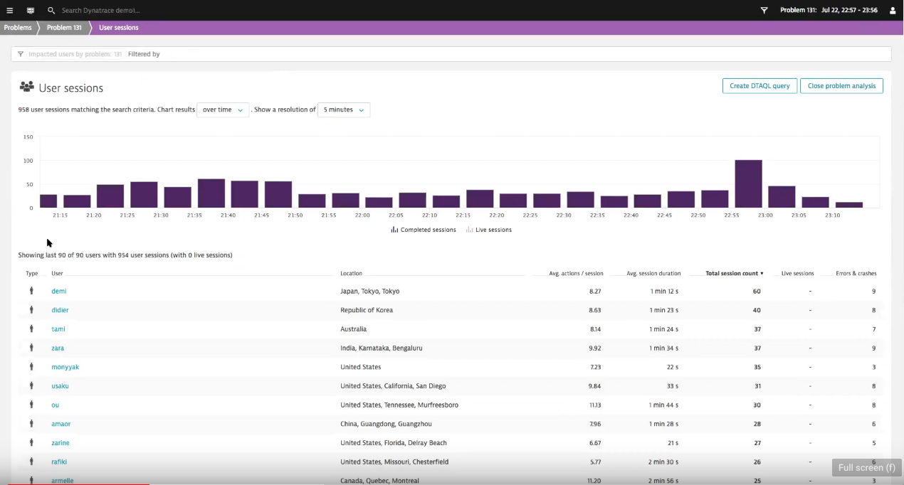
User monitoring
Independent User ID
Check user activity
Open sessions
Where (PC, Mobile App, OS, browser, ISP...)
Replay every click, tab

Slide 23
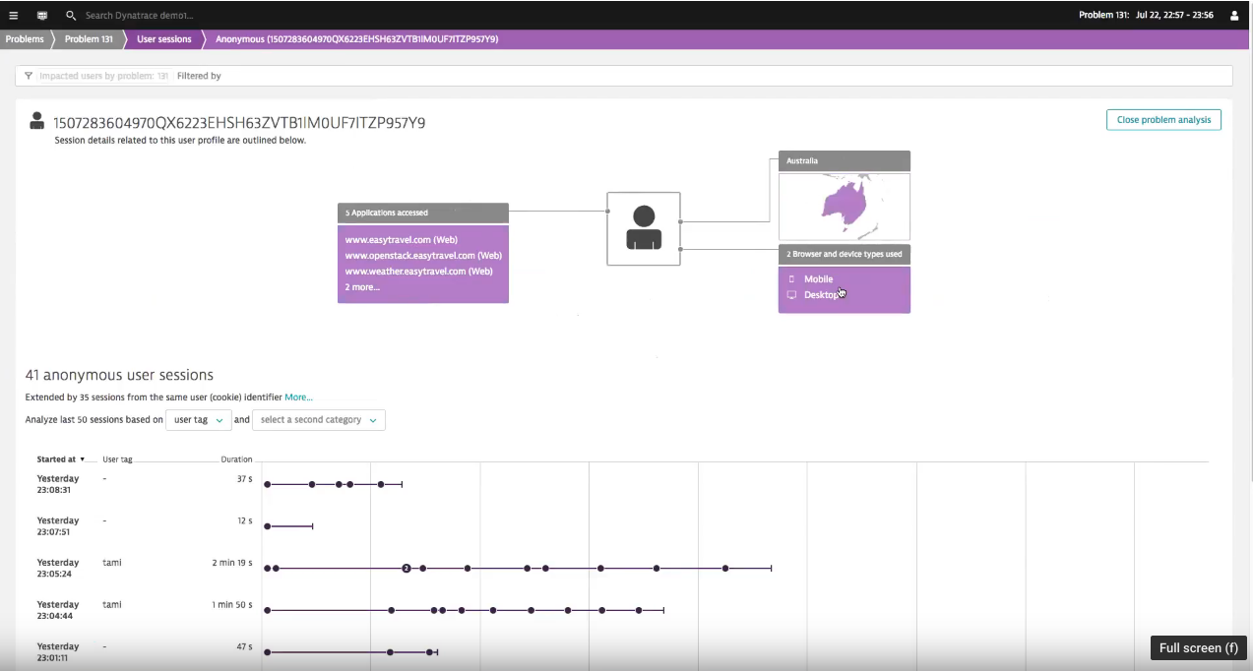
User monitoring
Independent User ID
Check user activity
Open sessions
Where (PC, Mobile App, OS, browser, ISP...)
Replay every click, tab

Slide 24
Questions ?

